Slide 1
PRINCIPLES OF ECONOMICS
Salimah Musharrif
FPEC 101 – LECTURE 4 Unit 1

Slide 2
Demand and Supply Analysis
Elasticity

Slide 3
Outline
Double Shifts
Elasticity of Demand and Supply

Slide 4
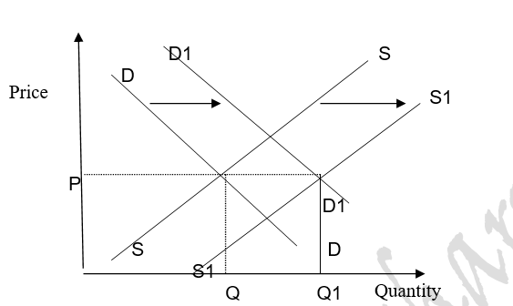
DEMAND INCREASE ,SUPPLY INCREASE
E1
E
If the increase in supply is greater than the increase in demand, the equilibrium price will fall. If the opposite holds, the equilibrium price will rise.
Equilibrium quantity will increase by an amount greater than that caused by either change alone.

Slide 5
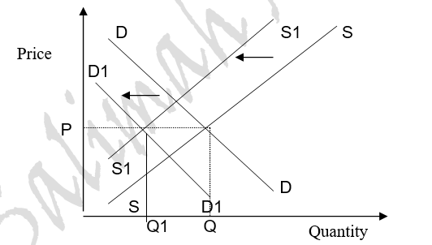
DEMAND DECREASE, SUPPLY DECREASE
E1
E
If the decrease in supply is greater than the decrease in demand, equilibrium price will rise. If the reverse is true, equilibrium price will fall.
Decreases in supply and in demand each reduce equilibrium quantity.

Slide 6
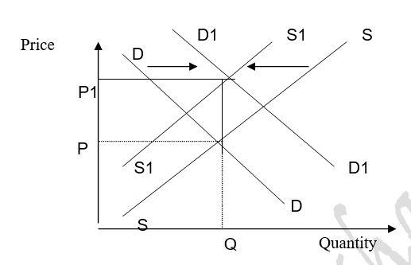
DEMAND INCREASE, SUPPLY DECREASE
E1
E
Increase in equilibrium price.
Effect on equilibrium quantity is again indeterminate, depending on the relative sizes of the changes in supply and demand. If the decrease in supply is larger than the increase in demand, the equilibrium quantity will decrease.
If the increase in demand is greater than the decrease in supply, the equilibrium quantity will increase.

Slide 7
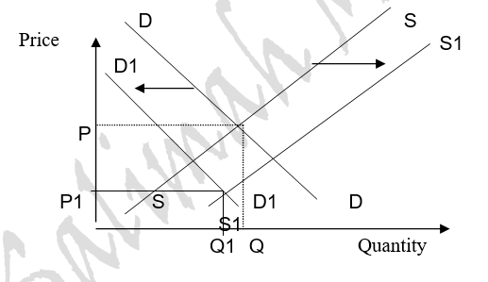
DEMAND DECREASE, SUPPLY INCREASE
E
E1
The increase in supply increases equilibrium quantity, but the decrease in demand reduces it.
The direction of the change in quantity depends on the relative sizes of the changes in
supply and demand.
If the increase in supply is larger than the decrease in demand, the equilibrium quantity will increase. But if the decrease in demand is greater than the increase in supply,
the equilibrium quantity will decrease.

Slide 8
ELASTICITY
When price ↑, what happens to Q.d?
Quantity Demanded Decreases↓
BUT!
How much does demand decrease?
Eg:
If price rises by 10%
The demand will decrease
  By more than 10%? Or
  By less than 10%?

Slide 9
ELASTICITY
“Elasticity is the responsiveness of quantity to a change in price”
In simple terms, it is the extent to which quantity changes with a change in price. It may also be said that it is a proportionate change in quantity due to a change in price. It is denoted by ‘E’
PED – Price Elasticity of Demand
PES – Price Elasticity of Supply

Slide 10
ELASTICITY
If a small change in price, produce a bigger change in demand → demand is elastic.
If a large change in price, produce a small change in demand → demand is inelastic.

Slide 11
PED Formula
PED =
% change in quantity demanded of a product
% change in price of that product
%△ Q
PED =
%△ P

Slide 12
PED Formula
Elasticity is always expressed in a positive value or with the I I sign.
When calculated, the sign that comes in calculation simply shows the relationship between price and quantity
So Elasticity of demand would have a negative sign while elasticity of supply would have a positive sign
The final answer however is expressed as a percentage while the interpretation is made on the figure before it is multiplied by 100.

Slide 13
PED Formula - Calculation
P | Qd
3 | 10
5 | 7
Q2-Q1/Q1
P2-P1/P1
7-10 / 10 = _ 3/10 = _ 0.3 = - 0.45
5-3 / 3 2/3 0.67
I0.45I x 100= 45%

Slide 14
PED Cases
There are five cases of Elasticity
E < 1 Relatively inelastic
E > 1 Relatively elastic Normal Cases
E = 1 Unitary Elasticity
E = 0 Perfectly inelastic Extreme Cases
E = ∞ Perfectly elastic

Slide 15
PED Formula - Interpretation
P | Qd
3 | 10
5 | 7
Q2-Q1/Q1
P2-P1/P1
7-10 / 10 = _ 3/10 = _ 0.3 = -0.45
5-3 / 3 2/3 0.67
Express _0.45 in modulus I-0.45I = 0.45 <1
Relatively inelastic demand

Slide 16
Elastic Demand
This means that a change in price brings about a more than proportionate change in quantity demanded.
E>1
Price (£)
10
7
D
5
Quantity Demanded
20

Slide 17
Inelastic Demand
This means that a change in price brings about a less than proportionate change in quantity demanded
E<1
Price (£)
10
5
D
5
6
Quantity Demanded

Slide 18
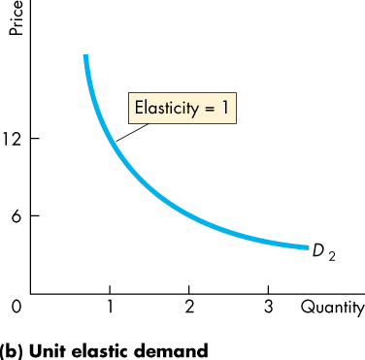
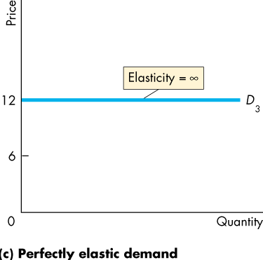
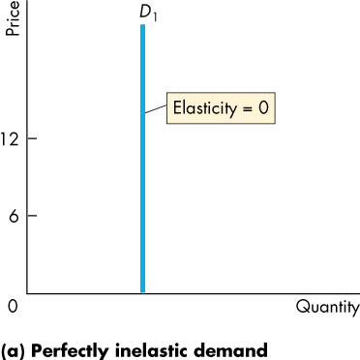
Elasticity of Demand
Change in price brings about absolutely no change in quantity demanded.
This means that a change in price brings about an equal or proportionate change in quantity demanded
This means that a change in price brings about an infinite change in quantity. Even a small change in price will create a new demand curve and quantity demanded at the previous price would be zero
Notes:
The unit elastic demand curve is a good one to use to emphasize that elasticity and slope are not equal. Have the students calculate the elasticity of supply on two linear demand curves that passes through the origin, one with a slope of 0.5 and the other with a slope of 2. They’ll get the message.

Slide 19
Determinants of Elasticity of demand
Availability of close substitutes
If substitutes are available, demand is elastic because the consumer can shift to the other product
Necessity or luxury
The demand for necessities is in elastic example fuel, salt.
Demand for luxuries is elastic example going on a vacation.
Income portion spent on commodity
If large, demand is elastic
If small, demand is in elastic as it does not form a major portion of income
Habit forming goods
Those which are addictive have inelastic demand
Time period
If long, or purchasing can be postponed there is a chance to look for substitute, so demand is elastic and vice Versa.

Slide 20
Importance of PED
  If it is elastic
    It can decide to decrease the price, to maximize sales → maximum profit
  If it is inelastic
    It can increase the price and earn more profits
    Or can pass the tax to the consumer

Slide 21
SUMMARY
Double Shifts
Elasticity of Demand
  Definition
  Formula
  Calculation
  Interpretation
  Factors / Determinants

